Slide 1
3-1 FORM AND BASIC MEANING OF THE SIMPLE PRESENT TENSE
SINGULAR PLURAL
1st PERSON
I walk
we walk
2nd PERSON
you walk
you walk
3rd PERSON
she walks
he walks
it walks
they walk

Slide 2
3-5 SPELLING AND PRONUNCIATION OF FINAL -ES
SPELLING
-sh
(a) push
pushes
-ch
(b) teach
teaches
-ss
(c) kiss
kisses
-x
(d) fix
fixes
endings
3rd person singular add -es
add -es

Slide 3
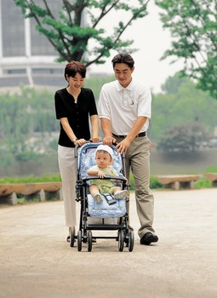
3-6 ADDING FINAL -S / -ES TO WORDS THAT END IN -Y
The baby cries a lot.

Slide 4
3-6 ADDING FINAL -S / -ES TO WORDS THAT END IN -Y
(a) cry
cries
3rd person singular
consonant + -y
change y to i,
add -es
fly
flies
(b) pay
pays
vowel + -y
add -s
enjoy
enjoys
buy
buys

Slide 5
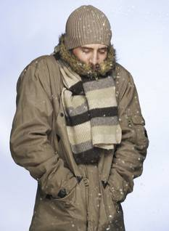
3-7 IRREGULAR SINGULAR VERBS: HAS, DOES, GOES
The man has a brown coat.

Slide 6
3-7 IRREGULAR SINGULAR VERBS: HAS, DOES, GOES
Irregular forms:
she
he
it
(a) I have a hat.
+
has
(b) She has a hat.
have
has
she
he
it
(c) I do exercises.
(d) He does exercises.
does
+
do
does
she
he
it
(e) We go to the gym.
(f) He goes to the gym.
+
goes
go
goes

Slide 7
3-9 THE SIMPLE PRESENT: NEGATIVE
They
You
We
I
(a) do not drink milk.
I
We
You
They
NEGATIVE:
+ do not + main verb
He
She
It
(b) does not drink milk.
She
He
It
+ does not + main verb

Slide 8
3-9 THE SIMPLE PRESENT: NEGATIVE
I do not drink milk.
She does not drink milk.
do and does = helping verbs
?
She does not drinks milk.
3rd person singular no -s on main verb

Slide 9
3-9 THE SIMPLE PRESENT: NEGATIVE
(c) I don’t drink milk.
They don’t go to the lake.
(d) He doesn’t drink milk.
Jack doesn’t like dogs.
CONTRACTIONS:
do not = don’t
does not = doesn’t

Slide 10
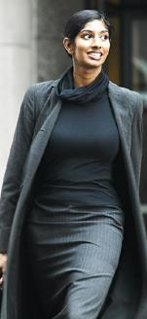
3-1 Let’s Practice
Jara _____ a walk in the morning.
takes
take
takes

Slide 11
3-1 Let’s Practice
watch
We _____ TV in the afternoon.
watch
watches

Slide 12
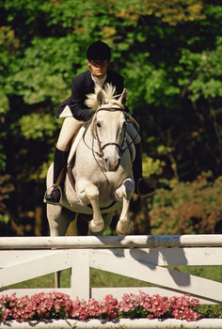
3-1 Let’s Practice
My friend doesn´t ____ her horse.
like
likes
like

Slide 13
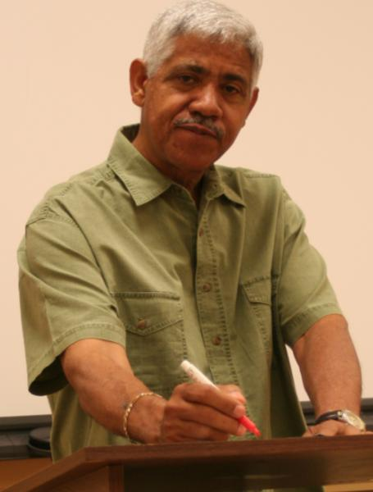
3-5 Let’s Practice
teach
Gerardo _______ math at PUCP
teaches

Slide 14
3-1 Let’s Practice
eat
We don´t ____ lunch at 12:00.
eat
eats

Slide 15
3-1 Let’s Practice
eat
We ____ lunch at 12:00.
eat
eats

Slide 16
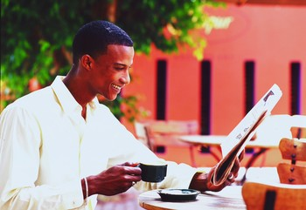
3-5 Let’s Practice
mix
Ade ______ sugar
in his coffee.
mixes

Slide 17
3-1 Let’s Practice
watches
He _______ television in the morning
watch
watches

Slide 18
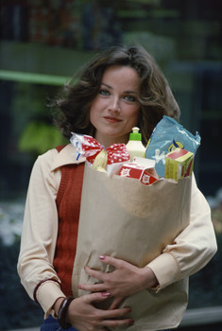
3-6 Let’s Practice
buy
Gazi _________ a lot of food.
buys

Slide 19
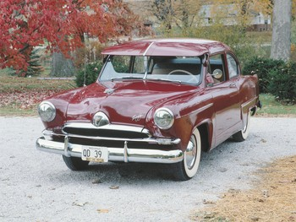
3-5 Let’s Practice
wash
washes
Viktor always _______ his car.

Slide 20
3-5 Let’s Practice
watch
Seung ______ his TV program.
watches

Slide 21
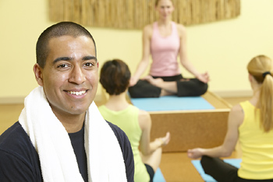
3-7 Let’s Practice
do does
George ____ yoga every day.
does

Slide 22
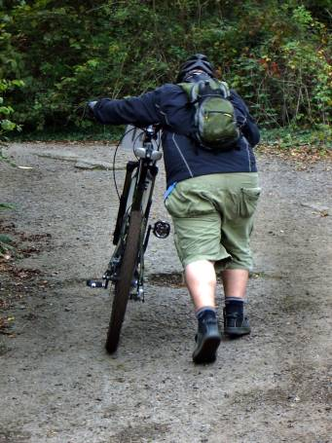
3-8 Let’s Practice
push
Mark ______ his
bike up the hill
every afternoon.
pushes

Slide 23
3-7 Let’s Practice
go goes
Zhou-li ______ for a walk on Sunday.
goes

Slide 24
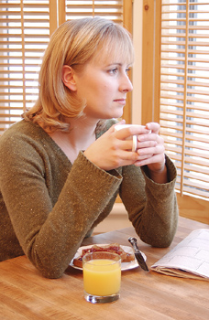
3-8 Let’s Practice
daydream
Brenda often ________
about her old home.
daydreams

Slide 25
3-7 Let’s Practice
have has
She always ____ homework.
has

Slide 26
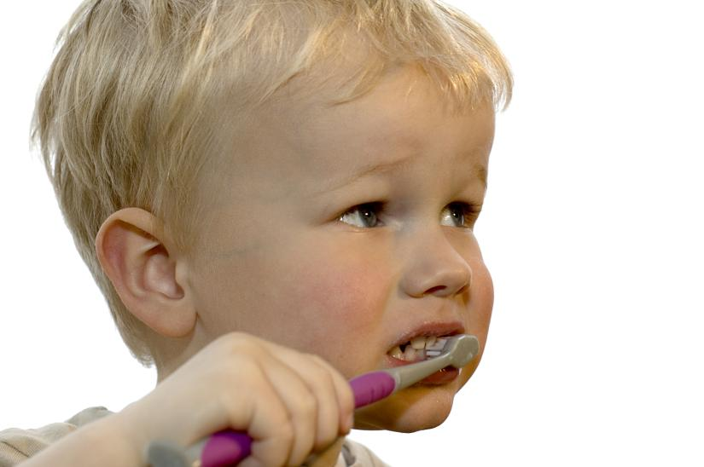
3-8 Let’s Practice
The child _______ his
teeth every morning.
brushes
brush

Slide 27
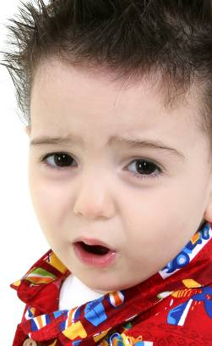
3-9 Let’s Practice
smile not
This child ___________.
doesn’t smile
(use the contraction)

Slide 28
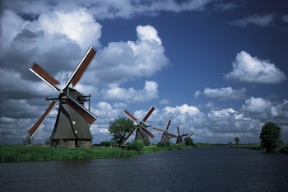
3-9 Let’s Practice
Magda ___________ Dutch.
doesn’t speak
(use the contraction)
speak
not

Slide 29
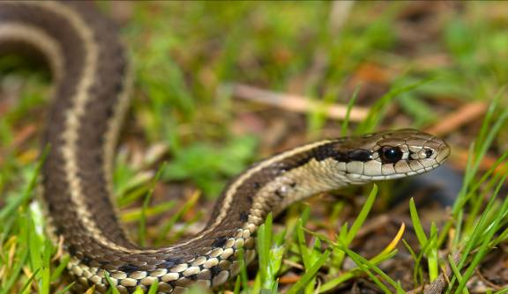
3-9 Let’s Practice
We ________ snakes.
don’t like
like not
(use the contraction)

Slide 30
3-9 Let’s Practice
don’t
doesn’t
eat
jump
run
speak
don’t
eat
Sometimes I ____ ____ my lunch.
My friend _____ it.
eats

Slide 31
3-9 Let’s Practice
don’t
doesn’t
sit
need
like
run
doesn’t
run
She ______ ____ fast at the gym.
She gets tired.

Slide 32
3-9 Let’s Practice
don’t
doesn’t
feed
jump
need
eat
They are good cooks.
need
don’t
They ____ ____ help.

